Slide 1

What is DevOps?

Slide 2
DevOps
A culture and a mindset for collaboration between developer and operations
Collaborative culture
Open mindset
Transparent processes
Error proof activity
What ?
How ?
Communication
Understanding
Integration
Relationship
Tools
Automation
Access Rights
Teams

Slide 3






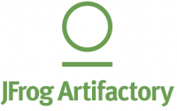
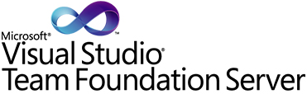













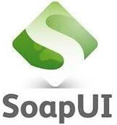


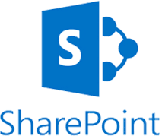






Deep Dive
Requirement
Backlog
Planning
Sprint planning
Build
Develop
Release
Test
Roll out
Prioritization
Unit test
Code quality review
Quality deployment
Functional testing
Integration testing
User Acceptance testing
Operate
Architecture
Design
Monitor (ELK)
Performance testing
Versioning
Pre-production deployment
Production deployment
Story board
Change is the only constant thing in Life and hence agility is new principle to adopt in life
Collaborate

Slide 4
Requirement Elaboration/Traceability
Create user stories and issues, plan sprints, and distribute tasks across your software team.
This is built for every member of your software team to plan, track, and release.
Prioritize and discuss your team’s work in full context with complete visibility.
Ship with confidence and sanity knowing the information you have is always up-to-date.
Improve team performance based on real-time, visual data that your team can put to use.

Slide 5




Integrated Development Environment
Visual studio, Eclipse, IntelliJ, Spyder are integrated development environment (IDE) used to facilitate guided coding. There are many more IDE available in market.
There are various plugin available for these IDE to make developer job easy, like automatic code completion, unit test generation, code template creation, code quality guidance etc.
Maven, NPM, Anaconda are third party library repository, which facilitate to import utility classes built and maintain by third part or open source community

Slide 6

Continuous Integration
In Continuous Integration after a code commit, the software is built and unit tested immediately. In a large project with many developers, commits are made many times during a day. With each commit code is built and tested. If the test is passed, build is tested for deployment. If deployment is a success, the code is pushed to production. This commit, build, test, and deploy is a continuous process and hence the name continuous integration/deployment.
A Continuous Integration Pipeline is a powerful instrument that consists of a set of tools designed to host, monitor, compile and test code, or code changes, like:
Source Control Tool (e.g., CVS, SVN, GIT, Mercurial, Perforce, ClearCase and others)
Build tool (Make, ANT, Maven, Ivy, Gradle, and others)
Automation testing framework (Selenium, Appium, TestComplete, UFT, and others)
Automated deployment (Docker, Docker Hub, Kubernetes Ansible)

Slide 7
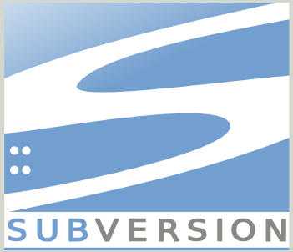
Source code management
Git/SVN is a free and open source distributed code version control system designed to handle everything from small to very large projects with speed and efficiency.
The code which is stored in Git keeps changing as more code is added. Also, many developers can add code in parallel. So Version Control System helps in handling this by maintaining a history of what changes have happened. Also, Git provides features like branches and merges.
Git/SVN help managing code in centralized manner to facilitate code quality management, build management, version release

Slide 8



Unit Testing and Code Quality
Junit/Nunit/MSTest is an Unit Testing Framework. It is useful for Developers to write and run repeatable tests. Developer can test module level extreme cases using these framework.
SonarQube collects and analyzes source code, measuring quality and providing reports for your projects. It combines static and dynamic analysis tools and enables quality to be measured continuously over time. Everything that affects our code base, from minor styling details to critical design errors, is inspected and evaluated by SonarQube, thereby enabling developers to access and track code analysis data ranging from styling errors, potential bugs, and code defects to design inefficiencies, code duplication, lack of test coverage, and excess complexity.
Cucumber is a testing tool that supports Behavior Driven Development (BDD) framework. Behavior Driven Development gives us an opportunity to create test scripts from both the developer’s and the customer’s perspective as well. So in the beginning, developers, project managers, QAs, user acceptance testers and the product owner (stockholder), all get together and brainstorm about which test scenarios should be passed in order to call this software/application successful. This way they come up with a set of test scenarios. All these test scripts are in simple English language, so it serves the purpose of documentation also.

Slide 9
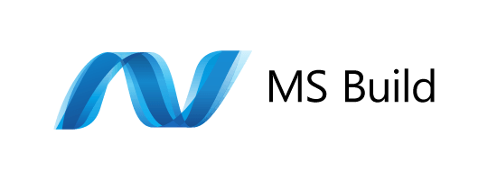
Code Build
MSBuild is a build tool that helps automate the process of creating a software product, including compiling the source code, packaging, testing, deployment and creating documentations. With MSBuild, it is possible to build Visual Studio projects and solutions without the Visual Studio IDE installed. MSBuild is free and open-source. MSBuild was previously bundled with .NET Framework; starting with Visual Studio 2013, however, it is bundled with Visual Studio instead. MSBuild is a functional replacement for the nmake utility. MSBuild 2017 for building .NET Framework, .NET Core, C#, F#, C++, and web projects.
Maven – Used to maintain third party library and there dependency while building Java libraries, web/enterprise application and portals.
NPM - Used to maintain third party library and there dependency while building JavaScript libraries, web/enterprise application and portals.
NG Build – Used for building angular application resolving all the requisite dependencies

Slide 10

Code Binary(Artifact) Repository
NuGet package is a single ZIP file with the .nupkg extension that contains compiled code (DLLs), other files related to that code, and a descriptive manifest that includes information like the package's version number. Developers with code to share create packages and publish them to a public or private host. Package consumers obtain those packages from suitable hosts, add them to their projects, and then call a package's functionality in their project code. NuGet itself then handles all of the intermediate details. NuGet itself maintains the central repository of over 100,000 unique packages at nuget.org. These packages are employed by millions of .NET/.NET Core developers every day.
An artifact repository manages your end-to-end artifact lifecycle and supports different software package management systems while providing consistency to your CI/CD workflow. An artifact repository is both a source for artifacts needed for a build, and a target to deploy artifacts generated in the build process.The DevOps artifact repository is crucial for the software development process. Multiple developers from different sites use artifacts and 3rd party components from different sources, causing testing problems to arise and thus slowing down your release process.

Slide 11
Think Microservices
Microservices describes the architectural pattern of composing a distributed application from separately deployable services that perform specific business functions and communicate over web interfaces. DevOps teams encapsulate individual pieces of functionality in microservices and build larger systems by composing the microservices like building blocks. Microservices apply an example of the open/closed principle: they are open for extension (using the interfaces they expose), and closed for modification (in that each is implemented and versioned independently).
Remove single points of failure (SPOFs) by ensuring issues in one service do not crash or impact other parts of an application.
Individual microservices can be scaled out independently to provide additional availability and capacity
Microservices nicely compliment cloud-based application architectures by allowing software development teams to take advantage of several patterns such as event-driven programming and autoscale scenarios. The microservice components expose APIs (application programming interfaces), typically over REST protocols for communicating with other services.

Slide 12
Containerization
A container is a standard unit of software that packages up code and all its dependencies so the application runs quickly and reliably from one computing environment to another. A Docker container image is a lightweight, standalone, executable package of software that includes everything needed to run an application: code, runtime, system tools, system libraries and settings. Container images become containers at runtime and in the case of Docker containers - images become containers when they run on Docker Engine. Containers allow for the isolation, packaging, and deployment of microservices, and orchestration scales out a group of containers into an application.
Docker is independent container platform that enables organizations to seamlessly build, share and run any application, anywhere—from hybrid cloud to the edge. Docker images helps faster deployment of any software component.
Docker Hub helps push Docker images and make your app accessible to your team or with the Docker Community at large. It also create and manage users and grant access to your repositories. This can be used for automated builds and webhooks for easy integration into your development pipeline.

Slide 13
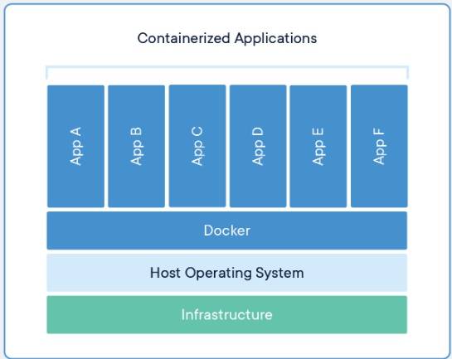
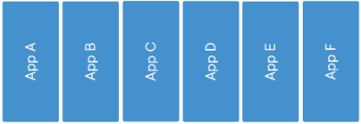
Container at Runtime
Containers are an abstraction at the app layer that packages code and dependencies together. Multiple containers can run on the same machine and share the OS kernel with other containers, each running as isolated processes in user space. Containers take up less space than VMs (container images are typically tens of MBs in size), can handle more applications and require fewer VMs and Operating systems.
If you have Docker installed on a bunch of hosts (different operating systems), you can leverage Kubernetes. These nodes, or Docker hosts, can be bare-metal servers or virtual machines. Kubernetes can then allow you to automate container provisioning, networking, load-balancing, security and scaling across all these nodes from a single command line or dashboard. A collection of nodes that is managed by a single Kubernetes instance is referred to as a Kubernetes cluster.
create container images (yaml)
Push container images
Pull container images
Manage container images @ runtime
Create container
Security
Load balancing
Scaling

Slide 14
Continuous Delivery / Infra as Code
Ansible is an open-source automation tool, or platform, used for IT tasks such as configuration management, application deployment, intra service orchestration and provisioning.
If you have Docker installed on a bunch of hosts (different operating systems), you can leverage Kubernetes. These nodes, or Docker hosts, can be bare-metal servers or virtual machines. Kubernetes can then allow you to automate container provisioning, networking, load-balancing, security and scaling across all these nodes from a single command line or dashboard. A collection of nodes that is managed by a single Kubernetes instance is referred to as a Kubernetes cluster.
Puppet - Manage infrastructure configuration and compliance at scale. Deploy updates quickly, securely, and predictably.
Chef - One consistent, collaborative, and transparent way to ship any application to any environment. Build, deploy, and manage everything in your pipelines and in production
Azure (ARM Template), AWS (Cloud Formation)

Slide 15
End to End Test Automation
Automate repeated testing. Provides more confidence to business owner about incremental change. Reduced human error and negligence.
IBM Functional Tester is an automated functional testing and regression testing tool. This software provides automated testing capabilities for functional, regression, GUI and data-driven testing. It supports a range of applications, such as web-based, .Net, Java, Siebel, SAP, terminal emulator-based applications, PowerBuilder, Ajax, Adobe Flex, Dojo Toolkit, GEF, Adobe PDF documents, zSeries, iSeries and pSeries.
HP QuickTest Professional (QTP), an automated functional testing tool that helps testers to perform automated regression testing in order to identify any gaps, errors/defects in contrary to the actual/desired results of the application under test.
TOSCA - Minimize test maintenance and maximize reuse so that rapid change doesn’t disrupt test automation
Rational Functional Tester

Slide 16
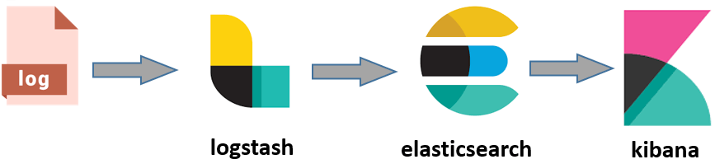
Operate and monitor – ELK Stack
Elastic search(E) for deep search and data analytics. Elasticsearch is a distributed, RESTful search and analytics engine capable of addressing a growing number of use cases. As the heart of the Elastic Stack, it centrally stores your data so you can discover the expected and uncover the unexpected.
Logstash(L) for centralized logging, log enrichment and parsing. Logstash is an open source, server-side data processing pipeline that ingests data from a multitude of sources simultaneously, transforms it, and then sends it to your favorite "stash."
Kibana(K) for powerful and beautiful data visualizations. Kibana lets you visualize your Elasticsearch data and navigate the Elastic Stack so you can do anything from tracking query load to understanding the way requests flow through your apps.

Slide 17
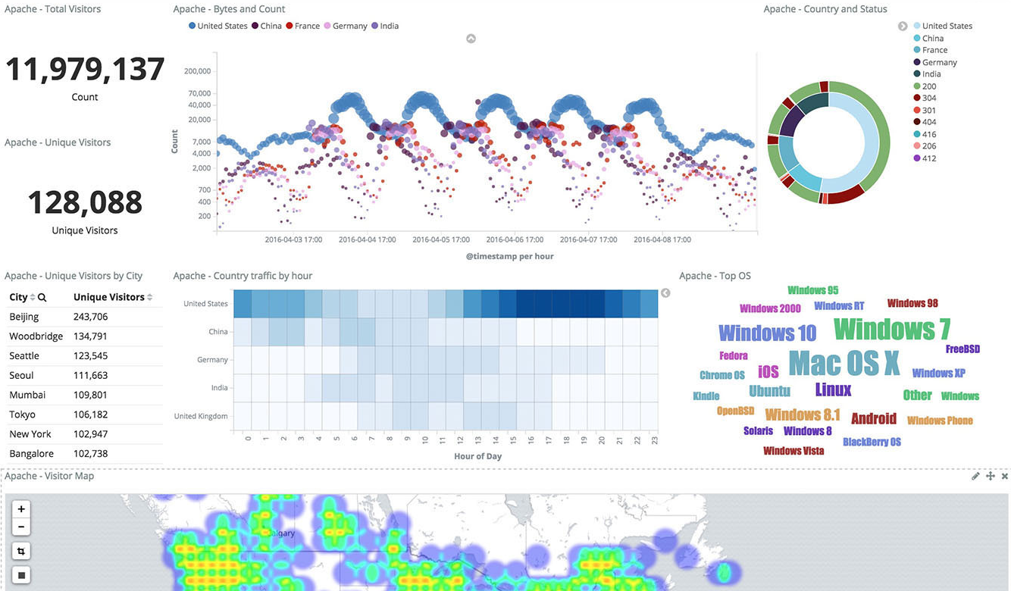
Kibana dashboard glimpse

Slide 18
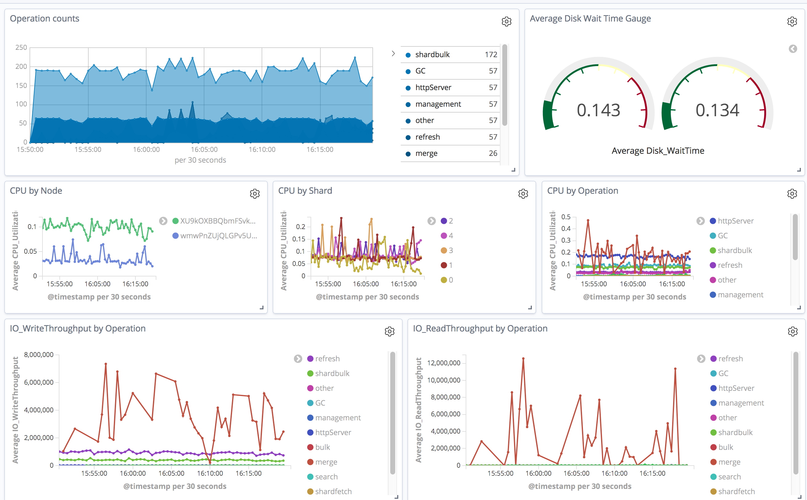
Kibana dashboard glimpse

Slide 19
References
https://azure.microsoft.com/en-us/solutions/devops/
https://aws.amazon.com/devops/
https://trello.com/en
https://www.atlassian.com/software/jira
https://www.atlassian.com/software/confluence
https://git-scm.com/book/en/v2/Getting-Started-Installing-Git
https://containerjournal.com/topics/container-ecosystems/kubernetes-vs-docker-a-primer/
https://jfrog.com/artifactory/
https://www.jfrog.com/confluence/display/RTF/NuGet+Repositories

Slide 20
Thank you

